Slide 1
ML driven high-pressure Li-Cu-H ternary hydrides discovery

Slide 2
NOTE
The study and results presented here represent an initial exploratory investigation.
While the predictions are grounded in well-established theoretical principles and robust machine-learning models, further detailed analysis—including literature review, additional calculations, and deeper physical interpretation—remains to be carried out.

Slide 3
Workflow
Generated ~2,000 Li–Cu–H structures using MatterGen, each with lattice constants and atomic coordinates (POSCAR format).
Used MatterSim + MLIP (trained on >5M structures) to fully relax all candidates under pressures from 0 to 100 GPa.
Collected stress, energy, enthalpy, and other properties from the relaxed structures.
Ran DFT calculations for pure Li, Cu, and H reference phases to obtain their accurate energetic baselines at the same pressures.
Evaluated formation enthalpy for every Li–Cu–H compound using the appropriate elemental and molecular reference states.

Slide 4
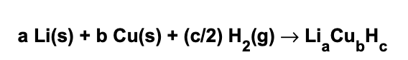
Workflow
Li-Cu-H formation/reaction
Formation enthalpy

Slide 5
Workflow
ML-predicted stable Li–Cu–H phases → re-optimized using full DFT relaxation
Post-relaxation SCF step yields accurate energies & enthalpies
Formation enthalpy recomputed using identical reference scheme
DFT convex hull built at each pressure
ML vs. DFT stability compared for consistency and validation

Slide 6
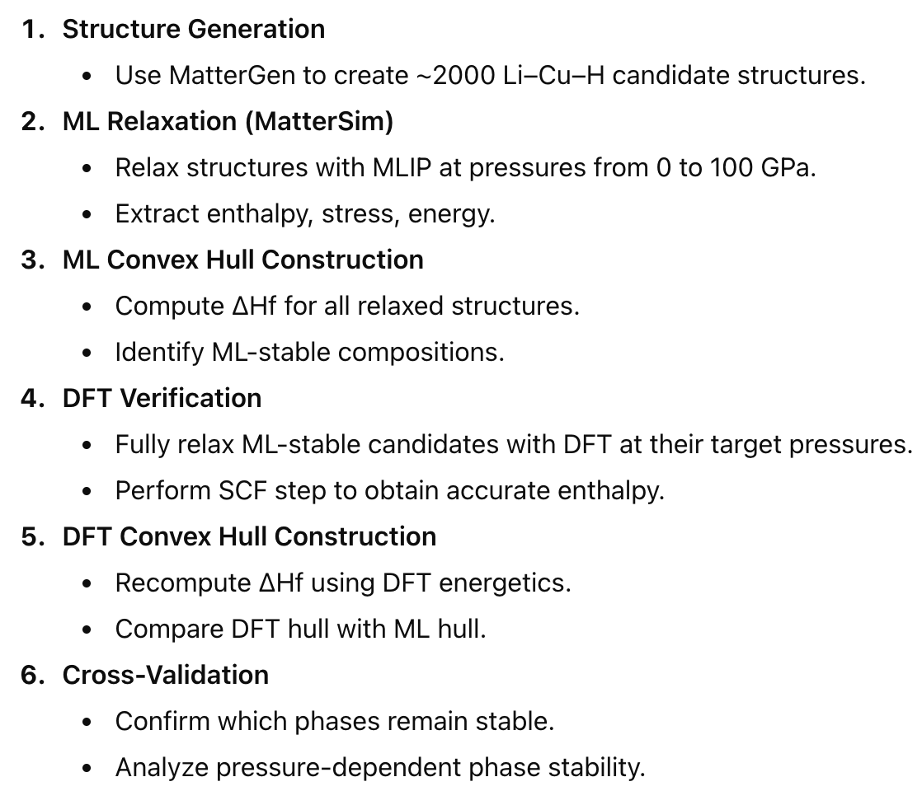
Overall Workflow

Slide 7
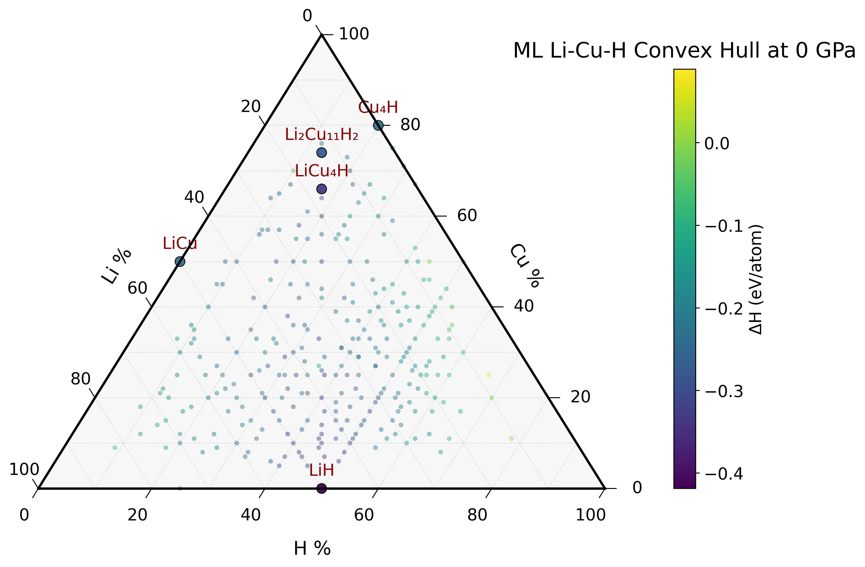
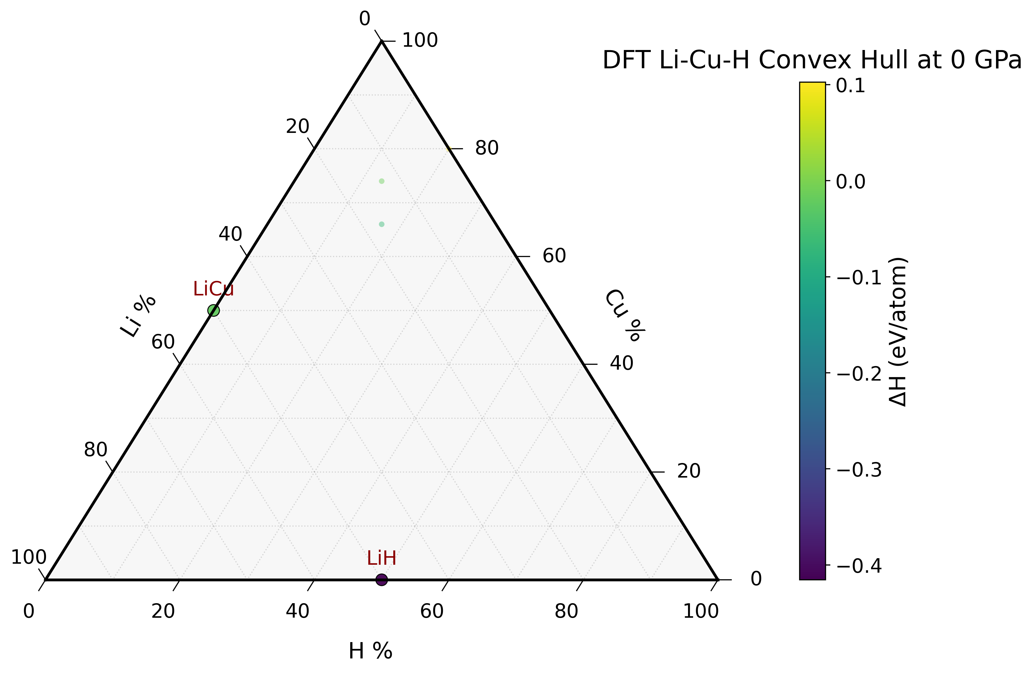
Results

Slide 8
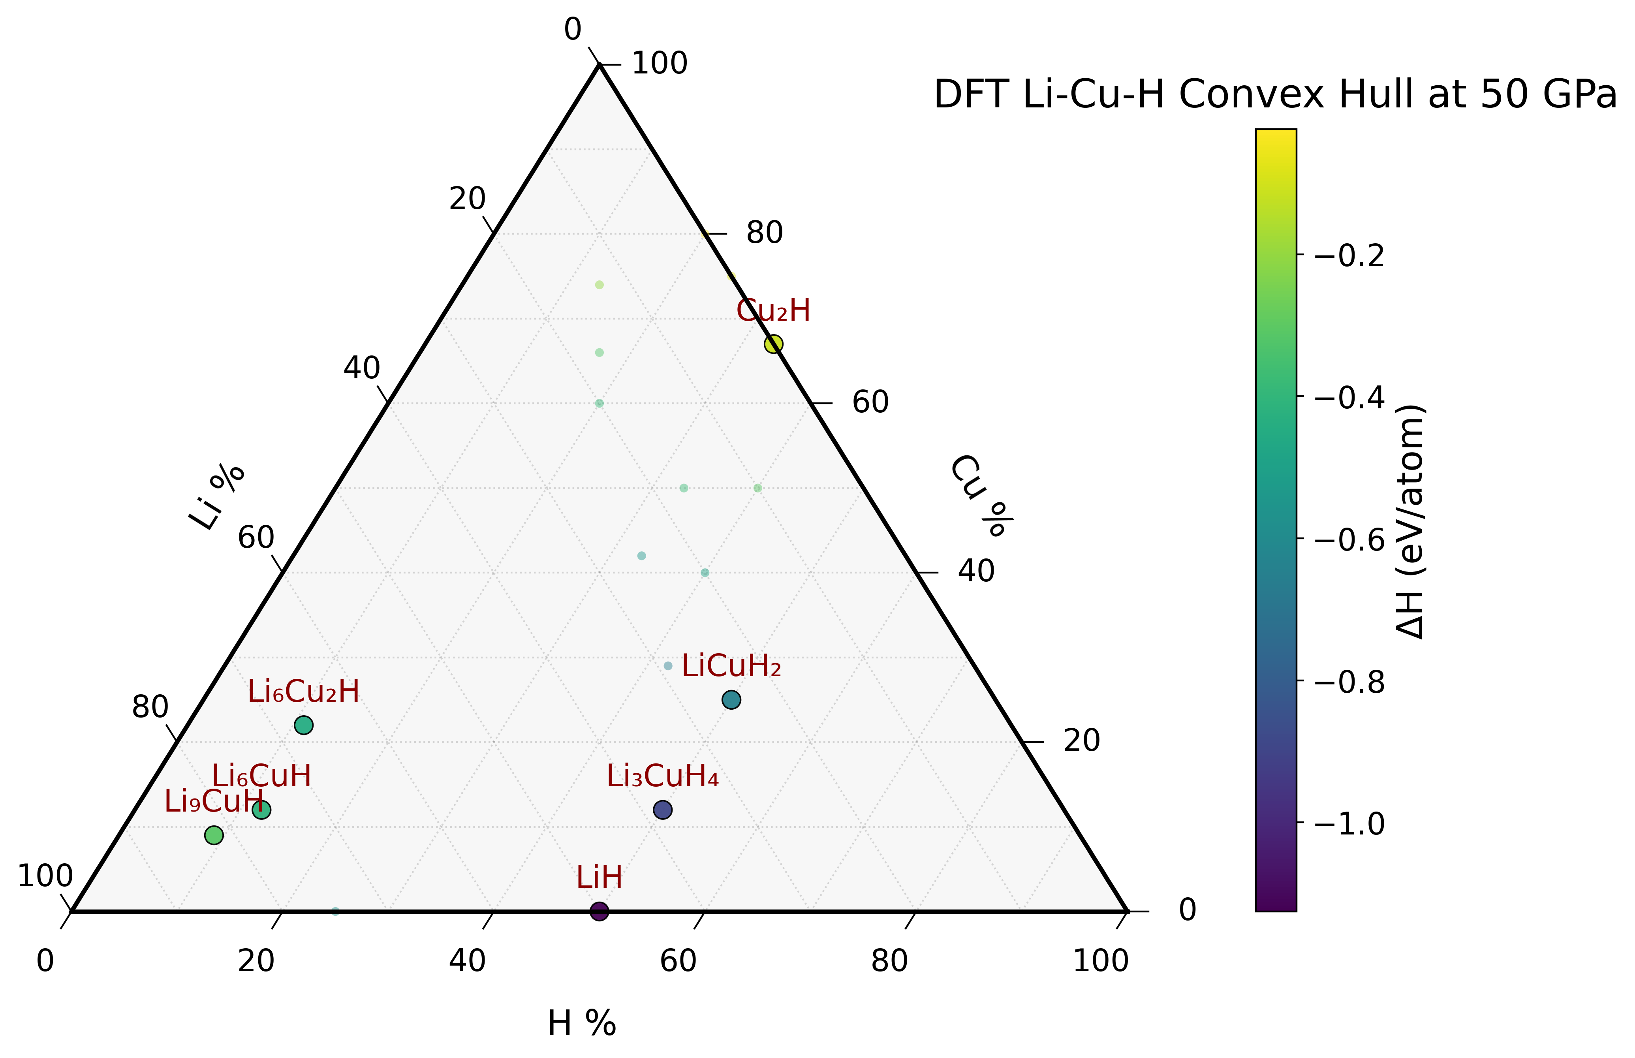
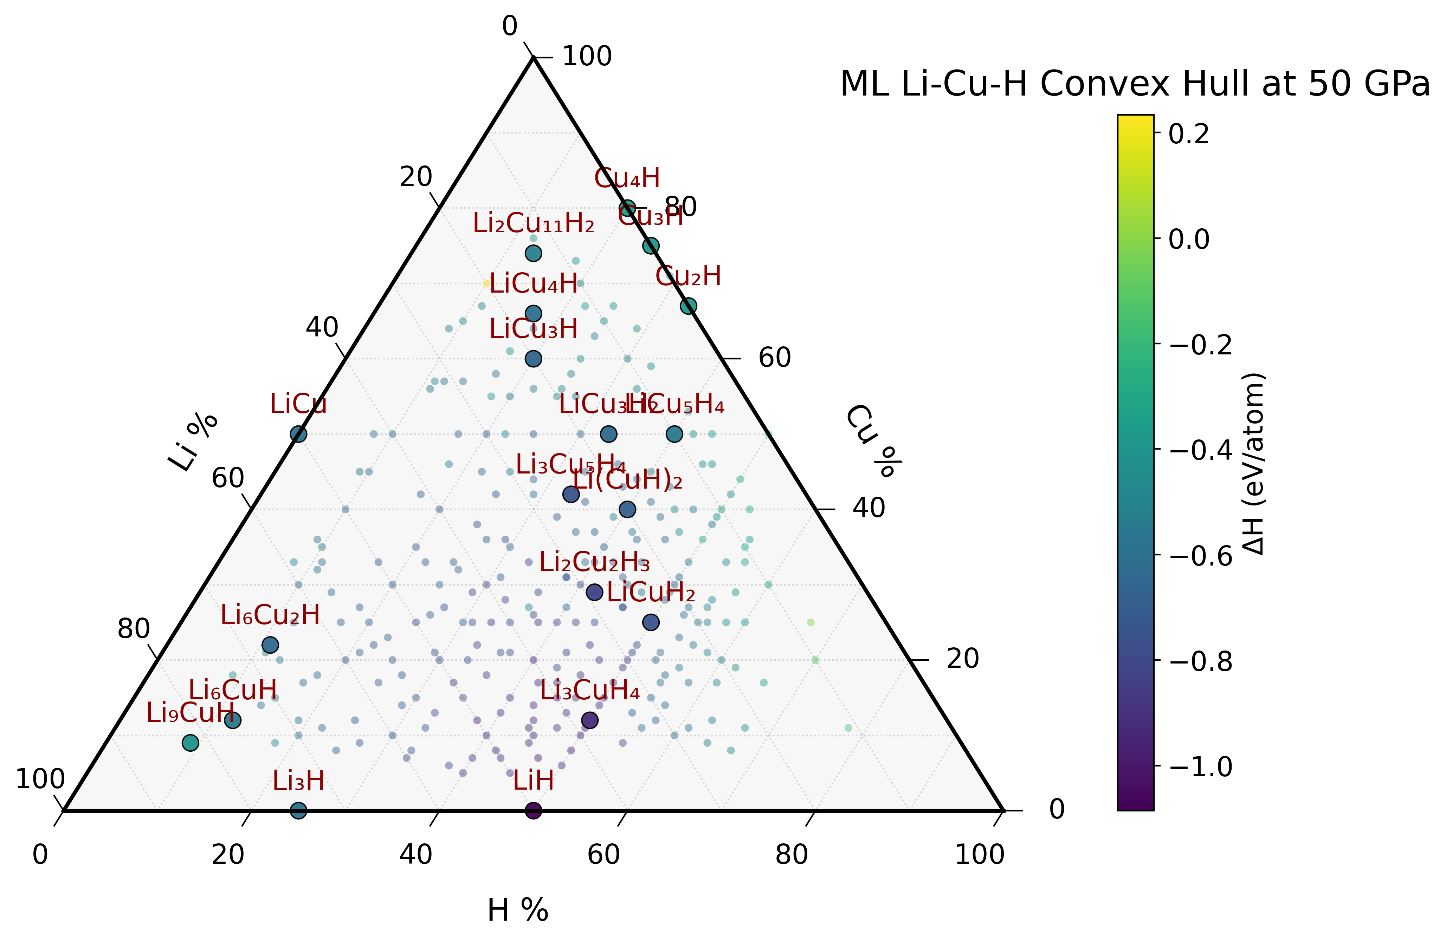

Slide 9
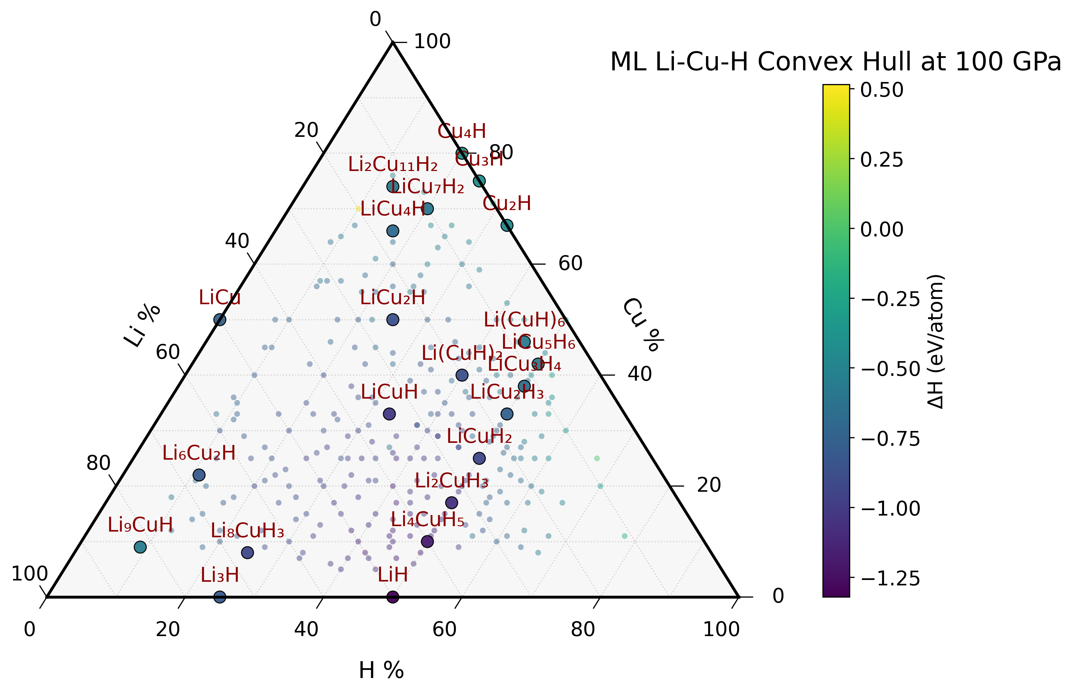
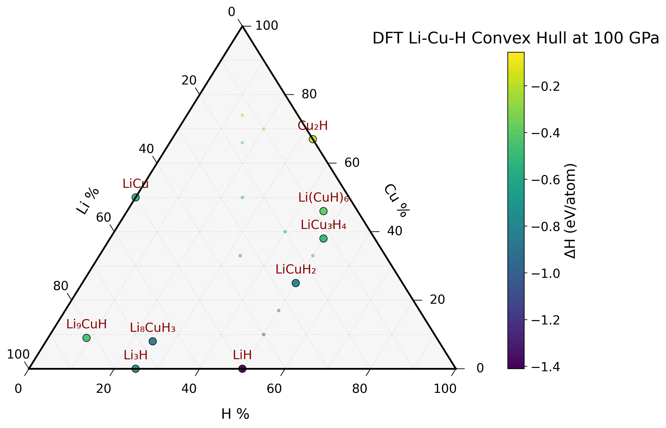

Slide 10
Detail Results
All convex hull plots stored in images folder
Data including stable structures, space group, energies, enthalpies, … in
outputs_hull_mattersim and
outputs_hull_DFT folders
and <P_GPa> and structures sub-folders inside

Slide 11
Key findings
At low pressure, as validated by ML plus DFT, the Li–Cu–H phase space is dominated by binary compounds, with LiH and LiCu forming the only stable phases.
As pressure increases, particularly beyond ~50 GPa, the energetic landscape shifts, enabling the stabilization of Li–Cu–H ternary compositions.

